Slide 1
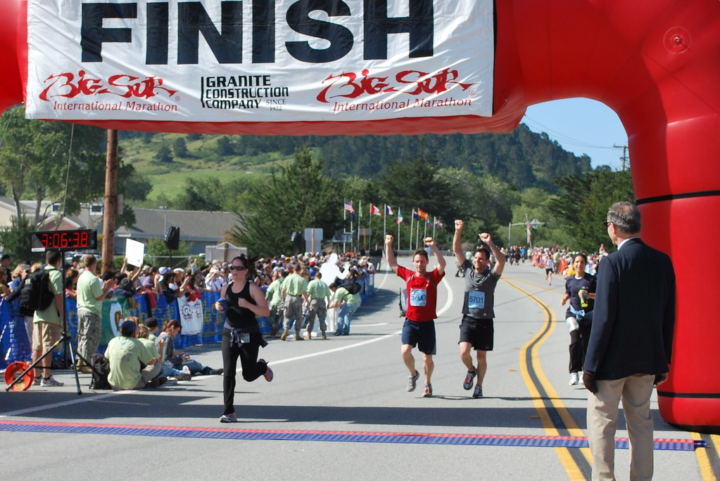
Week 11:Final self-assessment and project workshop
Geog4300: Shannon

Slide 2
Deadlines!
Final project due Tuesday, 12/7 on Github
Final self-assessment due Tuesday, 12/14 (our assigned finals date) on ELC
Notes:
Alternative hypothesis is usually what you’re trying to prove.

Slide 3
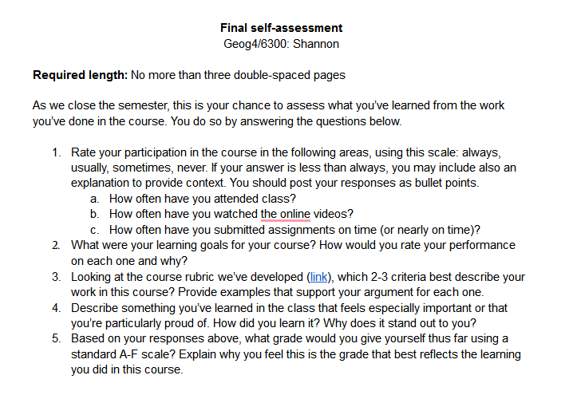
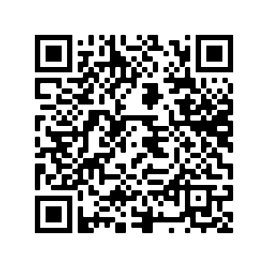
Final self assessment
Notes:
Alternative hypothesis is usually what you’re trying to prove.

Slide 4
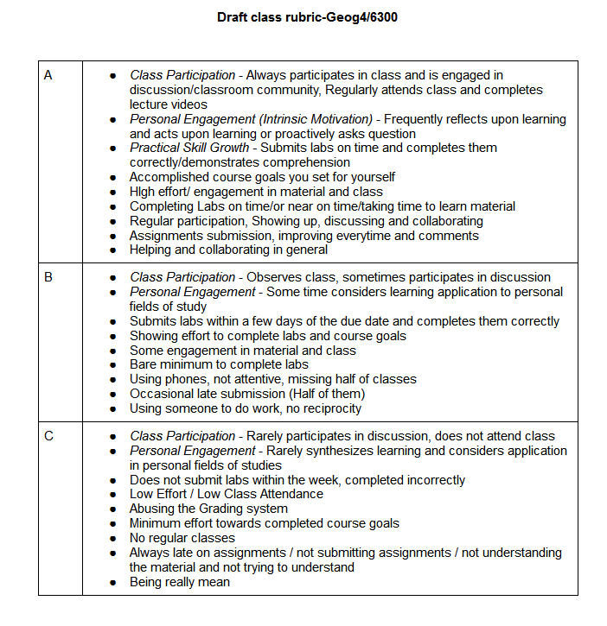
Revising the class rubric
What needs to be edited/ removed?
What’s missing?
Notes:
Alternative hypothesis is usually what you’re trying to prove.

Slide 5
Feedback on the course
What have you liked the most about the course design/structure/topics?
What’s been most difficult or confusing?
What should I change for next time?
Notes:
Alternative hypothesis is usually what you’re trying to prove.

Slide 6
Workshopping your project
What question are you answering?
What data are you using?
Notes:
Alternative hypothesis is usually what you’re trying to prove.

Slide 7
Workshopping your project
In pairs/threes: Share your project
Are the proposed methods appropriate—correct tests or other methods of analysis?
Does the researcher need to be more precise in the steps they will be following?
Does this project have a clear tie to the methods we have covered in class?
What’s most interesting about this project?
Does this project seem doable for a week-long assignment?
Notes:
Alternative hypothesis is usually what you’re trying to prove.

